Slide 1
Node Embeddings
1

Slide 2
Given an input graph, extract node, link and graph-level features, learn a model (SVM, neural network, etc.) that maps features to labels.
Recap: Traditional ML For Graphs
Input
Graph
Structured
Features
Learning
Algorithm
Prediction
Feature engineering
(node-level, edge-level, graph- level features)
Downstream prediction task
2

Slide 3
Graph Representation Learning
Graph Representation Learning alleviates the need to do feature engineering every single time.
Input
Graph
Structured
Features
Learning
Algorithm
Prediction
Feature Engineering
Representation Learning --
Automatically learn the features
Downstream prediction task
3

Slide 4
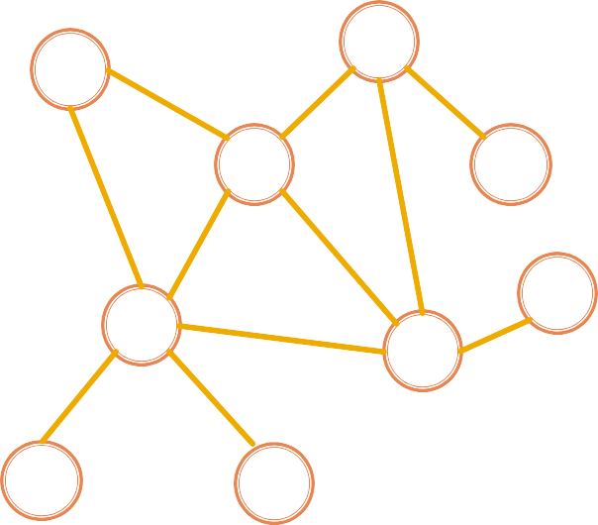
Goal: Efficient task-independent feature learning for machine learning with graphs!
Graph Representation Learning
node
𝑢
vector
𝑓: 𝑢 → ℝ^{𝑑}
_{ℝ}𝑑
Feature representation,
embedding
4

Slide 5
Why Embedding?
Task: Map nodes into an embedding space
Similarity of embeddings between nodes indicates their similarity in the network.
For example: Both nodes are close to each other (connected by an edge)
Encode network information
Potentially used for many downstream predictions
Vec
Tasks
Node classification
Link prediction
Graph classification
Anomalous node detection
Clustering
….
ℝ
𝑑
embeddings
5

Slide 6
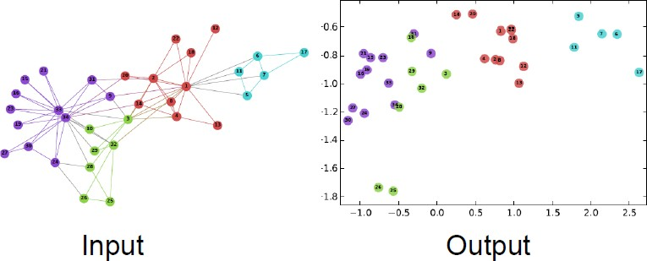
Example Node Embedding
2D embedding of nodes of the Zachary’s
Karate Club network:
Image from: Perozzi et al. DeepWalk: Online Learning of Social Representations. KDD 2014.
6

Slide 7
Node Embeddings: Encoder and Decoder
7

Slide 8


Setup
Assume we have a graph G:
V is the vertex set.
A is the adjacency matrix (assume binary).
For simplicity: No node features or extra information is used
4
3
2
⎛ 0 1 0 1⎞
⎜ ⎟
1 0 0 1
⎜ 0 0 ⎟
1 1 1 0
1
⎟
A = ⎜
V: {1, 2, 3, 4}
⎜ ₀
₁⎟
⎝
⎠
8

Slide 9
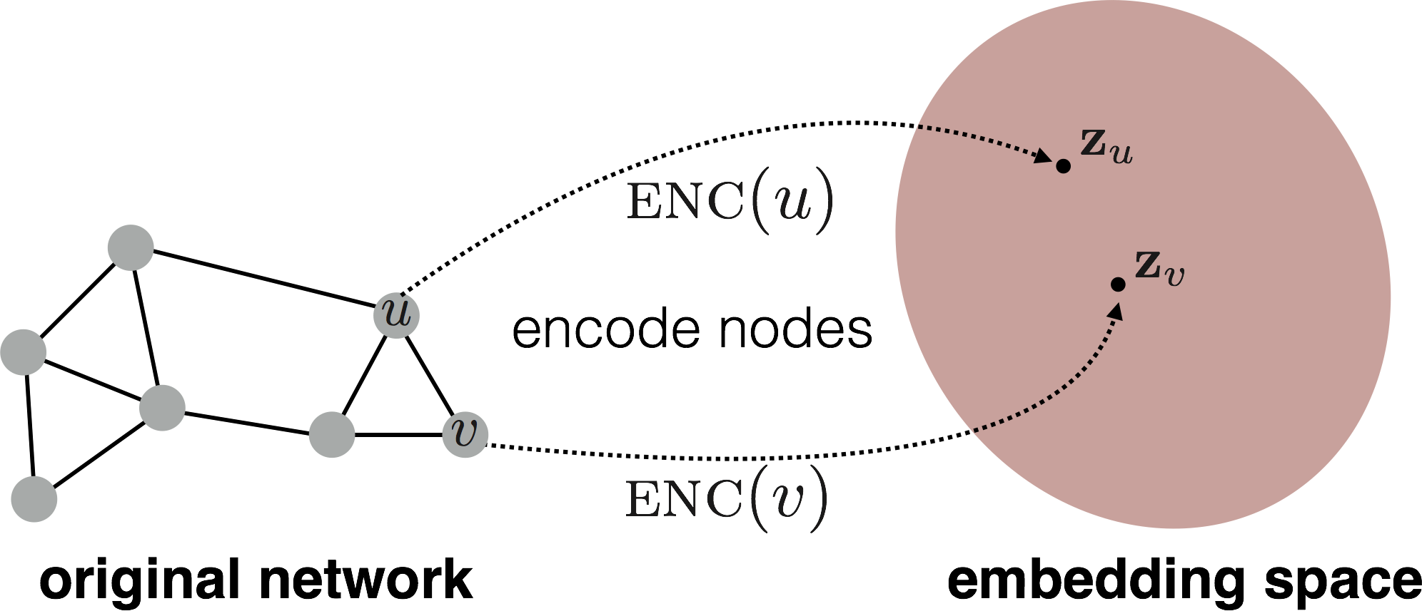
Embedding Nodes
Goal is to encode nodes so that similarity in the embedding space (e.g., dot product) approximates similarity in the graph
9

Slide 10

Embedding Nodes
Goal:
similarity 𝑢, 𝑣
in the original network
Need to define!
10

Slide 11
Node Embeddings Summary
Encoder ENC maps from nodes to embeddings
Define a node similarity function (i.e., a measure of similarity in the original network)
Decoder 𝐃𝐄𝐂 maps from embeddings to the similarity score
Optimize the parameters of the encoder so that:
similarity 𝑢, 𝑣
in the original network
𝐃𝐄𝐂(𝐳^{Τ}𝐳 )
𝑣 𝑢
≈ 𝐳^{Τ}𝐳
𝑣 𝑢
Similarity of the embedding
11

Slide 12
Two Key Components
Encoder: maps each node to a low-dimensional vector
node in the input graph
d-dimensional embedding
ENC 𝑣 =
𝐳_{𝑣}
Similarity function: specifies how the relationships in vector space map to the relationships in the original network
similarity 𝑢, 𝑣
≈ 𝐳^{Τ}𝐳
Decoder
𝑣 𝑢
Similarity of 𝑢 and 𝑣 in the original network
dot product between node embeddings
12

Slide 13





Simplest encoding approach: Encoder is just an embedding-lookup
“Shallow” Encoding
ENC(𝑣) = 𝐳_{𝒗} = 𝐙 ⋅ 𝑣
Matrix, each column is a node embedding [what we learn / optimize]
Indicator vector, all zeroes except a one in column indicating node v
13

Slide 14


Simplest encoding approach: Encoder is just an embedding-lookup
“Shallow” Encoding
embedding vector for a
specific node
embedding
matrix
Dimension/size
of embeddings
one column per node
14

Slide 15
“Shallow” Encoding
Simplest encoding approach: Encoder is just an embedding-lookup
Each node is assigned a unique embedding vector
(i.e., we directly optimize the embedding of each node)
15

Slide 16
Framework Summary
Encoder + Decoder Framework
Shallow encoder: embedding lookup
Parameters to optimize: 𝐙 which contains node embeddings 𝐳_{𝑢} for all nodes 𝑢 ∈ 𝑉
We will cover deep encoders (GNNs)
Decoder: based on node similarity.
Objective: maximize 𝐳^{Τ}𝐳 for node pairs (𝑢, 𝑣)
𝑣 𝑢
that are similar
16

Slide 17
How to Define Node Similarity
Key choice of methods is how they define node similarity.
Should two nodes have a similar embedding if they…
are linked?
share neighbors?
have similar “structural roles”?
17

Slide 18
Random Walk Approaches for Node Embeddings
18

Slide 19
A Note on Node Embeddings
We will now learn node similarity definition that uses random walks, and how to optimize embeddings for such a similarity measure.
Random walks is unsupervised/self-supervised way of learning node embeddings.
We are not utilizing node labels
We are not utilizing node features
These embeddings are task independent
They are not trained for a specific task but can be used for any task.
19

Slide 20
Notation
Vector 𝐳_{𝑢}:
The embedding of node 𝑢 (what we aim to find).
Probability 𝑃 𝑣 𝐳_{𝑢}) :
The (predicted) probability of visiting node 𝑣 on random walks starting from node 𝑢.
Our model prediction based on 𝐳_{𝑢}
20

Slide 21


Random Walk
10
9
12
2
Step 3
Step 4
8
Step 5
1
3
11
Given a graph and a starting point, we select a neighbor of it at random, and move to this neighbor; then we select a neighbor of this point at random, and move to it, etc.
The (random) sequence of points visited this way is a random walk on the graph.
4
Step 1
Step 2
6
5
7
21

Slide 22
Random Walk Embeddings
probability that u and v co-occur on a random walk over the graph
22

Slide 23
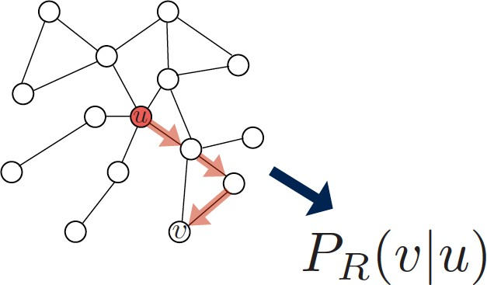
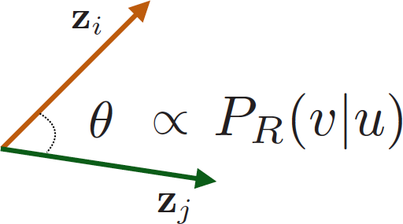
1. Estimate probability of visiting node 𝒗 on a random walk starting from node 𝒖 using some random walk strategy 𝑹
Random Walk Embeddings
2. Optimize embeddings to encode these random walk statistics:
Similarity in embedding space (Here:
dot product=cos(𝜃)) encodes random walk “similarity”
23

Slide 24
Why Random Walks
Expressivity: Flexible stochastic definition of node similarity that incorporates both local and higher-order neighborhood information. Idea: if random walk starting from node 𝑢 visits 𝑣 with high probability, 𝑢 and 𝑣 are similar (high-order multi-hop information).
Efficiency: Do not need to consider all node pairs when training; only need to consider pairs that co-occur on random walks.
24

Slide 25
Unsupervised Feature Learning
Intuition: Find embedding of nodes in 𝑑-dimensional space that preserves similarity.
Idea: Learn node embedding such that nearby nodes are close together in the network.
Given a node 𝑢, how do we define nearby nodes?
𝑁_{𝑅} (𝑢) … neighbourhood of 𝑢 obtained by some random walk strategy 𝑅.
25

Slide 26





Feature Learning as Optimization
Given 𝐺 = (𝑉, 𝐸),
Our goal is to learn a mapping 𝑓: 𝑢 → ℝ^{𝑑}:
𝑓(𝑢) = 𝐳_{𝑢}
Log-likelihood objective:
𝑁_{𝑅}(𝑢) is the neighborhood of node 𝑢 by strategy 𝑅
Given node 𝑢, we want to learn feature representations that are predictive of the nodes in its random walk neighborhood 𝑁_{𝑅} (𝑢).
26

Slide 27






Random Walk Optimization
Run short fixed-length random walks starting from each node 𝑢 in the graph using some random walk strategy R.
For each node 𝑢 collect 𝑁_{𝑅}(𝑢), the multiset* of nodes visited on random walks starting from 𝑢.
Optimize embeddings according to: Given node 𝑢, predict its neighbors 𝑁_{R}(𝑢).
Maximum likelihood objective
*𝑁_{𝑅} (𝑢) can have repeat elements since nodes can be visited multiple times on random walks
27

Slide 28




Random Walks: Summary
Run short fixed-length random walks starting from each node on the graph
For each node 𝑢 collect 𝑁_{𝑅}(𝑢), the multiset of nodes visited on random walks starting from 𝑢.
Optimize embeddings (using Stochastic Gradient Descent):
28

Slide 29
How should we Randomly walk?
So far we have described how to optimize embeddings given a random walk strategy R
What strategies should we use to run these random walks?
Simplest idea: Just run fixed-length, unbiased random walks starting from each node
(i.e., DeepWalk from Perozzi et al., 2013)
The issue is that such notion of similarity is too constrained
How can we generalize this?
Reference: Perozzi et al. 2014. DeepWalk: Online Learning of Social Representations. KDD.
29

Slide 30
Overview of node2vec
Goal: Embed nodes with similar network neighborhoods close in the feature space.
We frame this goal as a maximum likelihood optimization problem, independent to the downstream prediction task.
Key observation: Flexible notion of network neighborhood 𝑁_{𝑅} (𝑢) of node 𝑢 leads to rich node embeddings
Develop biased 2nd order random walk 𝑅 to generate network neighborhood 𝑁_{𝑅} (𝑢) of node 𝑢
Reference: Grover et al. 2016. node2vec: Scalable Feature Learning for Networks. KDD.
30

Slide 31























Idea: use flexible, biased random walks that can trade off between local and global views of the network (Grover and Leskovec, 2016).
Node2vec: Biased Walks
s₁
s₂
s₈
s
BFS DFS
7
u
s₆
s₄
s₉
s
s
3
5
31

Slide 32




Two classic strategies to define a neighborhood 𝑵_{𝑹}(𝒖) of a given node 𝒖:
Node2vec: Biased Walks
s₁
s₂
s₈
s
BFS DFS
7
u
s₆
s₄
s₉
s
s
3
5
Walk of length 3 (𝑁_{𝑅}(𝑢) of size 3):
^{𝑁}𝐵𝐹𝑆
^{𝑁}𝐷𝐹𝑆
𝑢 = { 𝑠₁, 𝑠₂, 𝑠₃}
𝑢 = { 𝑠₄, 𝑠₅, 𝑠₆}
Local microscopic view Global macroscopic view
32

Slide 33
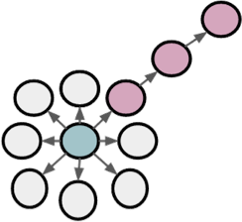


BFS vs. DFS
u
BFS:
Micro-view of neighbourhood
DFS:
Macro-view of neighbourhood
33

Slide 34
Biased fixed-length random walk 𝑹 that given a node 𝒖 generates neighborhood 𝑵_{𝑹}(𝒖)
Interpolating BFS and DFS
Two parameters:
Return parameter 𝒑:
Return back to the previous node
In-out parameter 𝒒:
Moving outwards (DFS) vs. inwards (BFS)
Intuitively, 𝑞 is the “ratio” of BFS vs. DFS
34

Slide 35
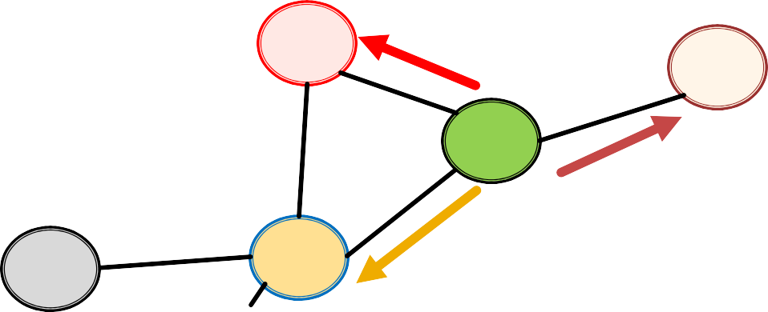
Biased 2nd-order random walks explore network neighborhoods:
Biased Random Walks
Rnd. walk just traversed edge (𝑠₁, 𝑤) and is now at 𝑤
Insight: Neighbors of 𝑤 can only be:
Same distance to 𝒔_{𝟏}
s₂
s₃
Farther from 𝒔_{𝟏}
w
s₁
Back to 𝒔_{𝟏}
u
Idea: Remember where the walk came from
35

Slide 36
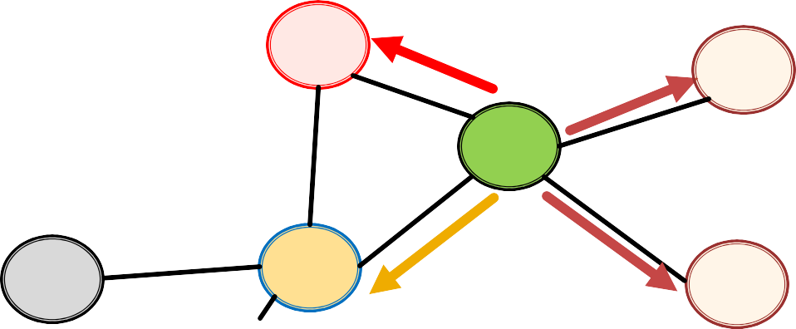
Biased Random Walks
Walker came over edge (𝐬_{𝟏}, 𝐰) and is at 𝐰. Where to go next?
s₂
1
1/𝑞 s₃
1/𝑝, 1/𝑞, 1 are unnormalized probabilities
w
1/𝑞
u
s
1/𝑝
s₄
1
𝑝, 𝑞 model transition probabilities
𝑝 … return parameter
𝑞 … ”walk away” parameter
36

Slide 37
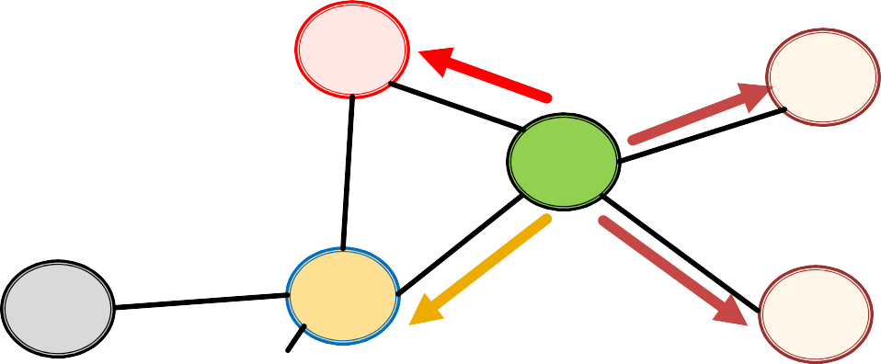
Biased Random Walks
Walker came over edge (𝐬_{𝟏}, 𝐰) and is at 𝐰. Where to go next?
Target 𝒕 Prob. Dist. (𝒔_{𝟏}, 𝒕)
0
1
2
2
s₂
1
1/𝑞 s₃
s₁ s₂ s₃ s₄
1/𝑝
1
1/𝑞
1/𝑞
w
w →
1/𝑞
u
s₁
1/𝑝
s₄
BFS-like walk: Low value of 𝑝
DFS-like walk: Low value of 𝑞
Unnormalized transition prob. segmented based on distance from 𝑠!
𝑁_{𝑅}(𝑢) are the nodes visited by the biased walk
37

Slide 38
Node2vec Algorithm
Compute random walk probabilities
Simulate 𝑟 random walks of length 𝑙 starting from each node 𝑢
Optimize the node2vec objective (using Stochastic Gradient Descent)
Properties: 1) Linear-time complexity 2) All 3 steps are individually parallelizable
38

Slide 39
Summary so far
Core idea: Embed nodes so that distances in embedding space reflect node similarities in the original network.
Different notions of node similarity:
Naïve: similar if two nodes are connected
Neighborhood overlap (covered in Topic 5)
Random walk approaches
39

Slide 40
Summary so far
No one method wins in all cases….
E.g., node2vec performs better on node classification while alternative methods perform better on link prediction (Goyal and Ferrara, 2017 survey).
Random walk approaches are generally more
efficient.
So what method should I use..?
Choose definition of node similarity that matches your application.
40

Slide 41
We discussed graph representation learning, a way to learn node and graph embeddings for downstream tasks, without feature engineering.
Learning Outcomes
Encoder-decoder framework:
Encoder: embedding lookup
Decoder: predict score based on embedding to match node similarity
Node similarity measure: (biased) random walk
Examples: Node2Vec
41
Acknowledgement: Jure Leskovec, Stanford University

